Slide 1
Predicting Economic Freedom of Countries
John Alino

Slide 2
Overview
1. Project Goal
2. Data Exploration and Preprocessing
3. Data Analysis
4. Conclusion

Slide 3
Project Goal
Determine which variables have the most correlation when predicting the economic freedom of a country based on five main areas: Size of Government, Legal System and Property Rights, Sound Money, Freedom to Trade Internationally, and Regulation.

Slide 4
Data Exploration and Preprocessing
Dataset Summary
3,726 observations
36 variables
2 categorical features and 34 numerical features
Variable to be predicted – ECONOMIC.FREEDOM

Slide 5
Data Exploration and Preprocessing
List all the features that contain more than 40% missing variables
X2a_judicial_independence, X2h_reliability_police, X2i_business_cost_crime
Make a cross table for each variable to confirm if they should be disregarded or maintained in the dataset
All variables had a low p-value, thus there were no features that were removed

Slide 6
Data Exploration and Preprocessing
Handle missing variables
Both categorical variables had no missing values, so no action needed
For the numerical values, assigned the mean of that column to fill in the NAs

Slide 7
Data Exploration and Preprocessing
Draw plots of each variable
At a quick glance, it looks like each variable has some correlation with ECONOMIC.FREEDOM
Make a correlation table of all variables
Based on the results, most variables have a little correlation with ECONOMIC.FREEDOM, with the exceptions of rank, quartile, X1a_government_consumption, and X1b_transfers

Slide 8
Data Analysis
RMSE of each model
Best performing is GBT, while Neural network has the worst RMSE
Model | RMSE
Lasso linear regression | 0.2470609
Ridge linear regression | 0.2685492
Random forest | 0.2097298
GBT | 0.2025671
Neural network | 4.913784

Slide 9
Data Analysis
Lasso Linear Regression Coefficients
These are the top correlated variables based on their coefficients
Feature | Coefficient
Government consumption | 9.917899e-04
Sound money | 9.347317e-03
Rank | 8.743194e-04
Inflation | 5.543481e-02
Money growth | 4.658241e-02

Slide 10
Data Analysis
Random Forest
These are the top features according to the random forest model
Feature | Overall
Regulation | 100
Trade | 89.10
Size government | 87.19
Quartile | 86.33
Control movement capital ppl | 79.36
Rank | 79.25
Sound money | 78.75

Slide 11
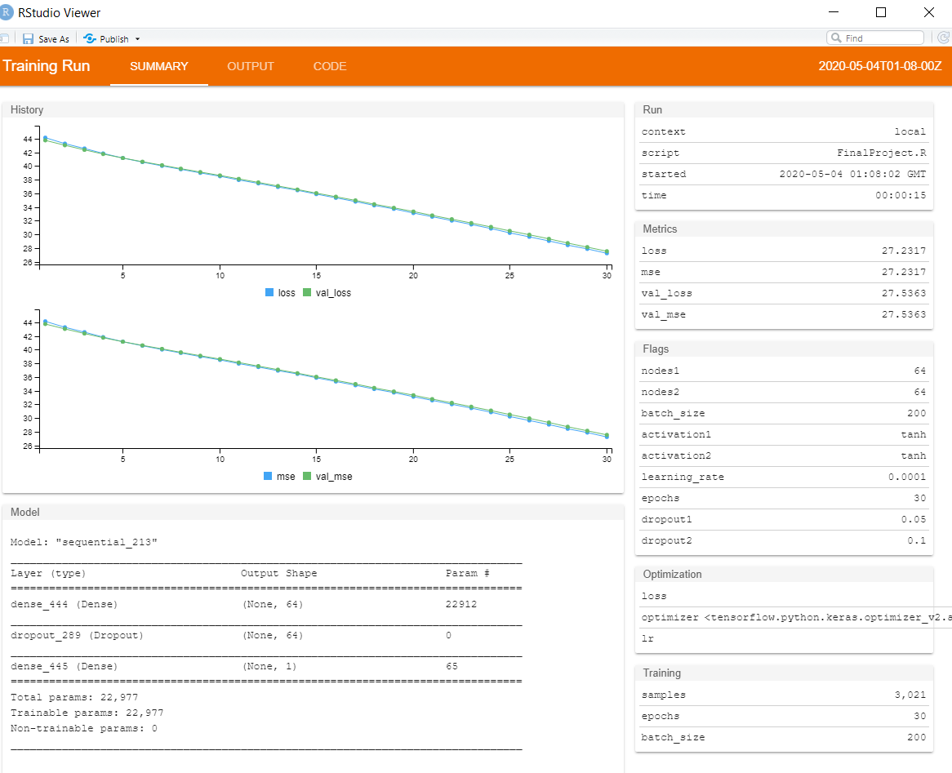
Data Analysis
Hyper-tuned Neural Network Model
Best Parameters
nodes1 = 64, nodes2 = 64, batch_size = 200, activation1 = “tanh”, activation2 = tanh, learning_rate = 0.0001, epochs = 30, dropout1 = 0.05, dropout2 = 0.1

Slide 12
Conclusion
All models performed consistently with similar RMSE
Lots of improvement can still be done for the Neural Network Models
Further research can still be done to make more complex predictions

